Slide 1
5 Skills You Must Master to Excel (as a Developer)
Michael Eaton
Principal Consultant, Improving
Beer City Code, August 11, 2023

Slide 2


Slide 3
The 5 Skills
Continuous Learning / Continuous Improvement
Data Collection
Sharing Knowledge
Emotional Intelligence
Leading Up

Slide 4
Who am I?
Husband
Father
Son
Caretaker of three cats
Developer with almost 30 years professional experience
Principal Consultant at Improving

Slide 5
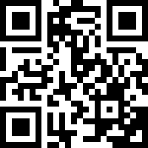
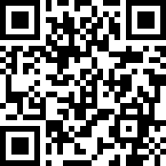
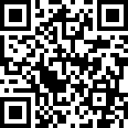
Improving
Improving is a modern digital services company that offers IT consulting, software development, and agile training across the globe. Our innovative solutions have helped thousands of our clients realize their tactical and strategic business objectives, allowing them to achieve great new heights in a competitive and ever-changing market.
Improving’s website https://improving.com
Improving Careers and Open Positions https://improving.com/careers
Improving Training and Upcoming Classes https://improving.com/services/training/

Slide 6
Goals of this session
To help debunk the misconception that technical prowess alone defines success.
To provide you with strategies and tactics related to the 5 “things” so you can get started tomorrow

Slide 7
Questions to consider
Who owns your career?
What are the most important day-to-day professional assets you bring to the table?

Slide 8
Data Collection
What

Slide 9
Data Collection
Why

Slide 10
Data Collection
How

Slide 11
Continuous Learning
What

Slide 12
Continuous Learning
Why

Slide 13
Continuous Learning
How

Slide 14
Sharing Knowledge
What

Slide 15
Sharing Knowledge
Why

Slide 16
Sharing Knowledge
How

Slide 17
Emotional Intelligence
NOUN
The capacity to be aware of, control, and express one’s emotions, and to handle interpersonal relationships judiciously and empathetically
Unlike our Intelligence Quotient (IQ), EQ can be learned and improved

Slide 18
Self Awareness
Your ability to accurately perceive your emotions and stay aware of them as they happen.
Notes:
Self Awareness is having a clear perception of your personality, including strengths, weaknesses, thoughts, beliefs, motivation, and emotions. Self Awareness allows you to understand other people, how they perceive you, your attitude and your responses to them in the moment.

Slide 19
Self Management
Your ability to use awareness of your emotions to stay flexible and positively direct your behavior.

Slide 20
Social Awareness
Your ability to accurately pick up on emotions in other people and get what is really going on.

Slide 21
Relationship Management
Your ability to use awareness of your emotions and the emotions of others to manage interactions successfully.
Notes:
You use your self-awareness skills to notice your feelings and judge if your needs are being satisfied. You use your self-management skills to express your feelings and act accordingly to benefit the connection. Finally, you use your social awareness skills to better understand the other person’s needs and feelings.

Slide 22
Emotional Intelligence
EQ is so critical to success that it accounts for 58 percent of performance in all types of jobs. It’s the single biggest predictor of performance in the workplace and the strongest driver of leadership and personal excellence.

Slide 23


Slide 24
Emotional Intelligence

Slide 26
Leading Up
“Adding value to those above you…”
It is NOT kissing up.
It is supporting your leader, adding value to the organization, and distinguishing yourself from the pack by doing your work with excellence.
It is influencing.

Slide 27
Leading Up
Why

Slide 28
Leading Up
How

Slide 29
Summary
Everything in the previous slides builds on each other. If you continuously learn, collect data, share your knowledge, work on your emotional intelligence and lead up, you will be doing more than a large percentage of your coworkers.

Slide 30
Key Takeaways
Your ability to code is a small part of what makes you a good developer
Continue learning and continue improving. Be better tomorrow than you are today.
Sharing what you know not only helps others it helps you solidify your knowledge!
Work on your Emotional Intelligence!
Help your leader help you!

Slide 31
Questions?

Slide 32
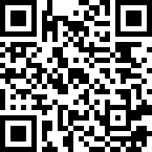
Contact Info
My personal website/blog with my contact information. https://samestuffdifferentday.com

